Slide 1
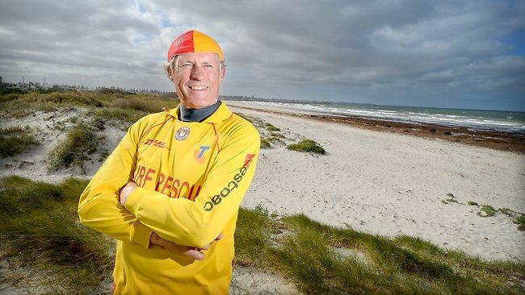



[BORDER];
[MOVEABLE];
[WASDMovement];
[NAME=test];
[NAME=Basic transparency];
[MOVEABLE];
[BORDER];[TRANSPARENT];[BOUNCING];
[AnimationSpeed=10]
Notes:
[BCKCOLOR=115,155,234];
[TESTPROPERTY]

